Slide 1
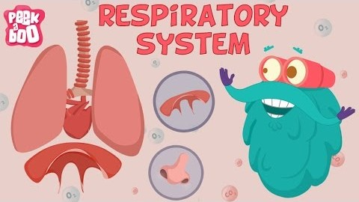

Slide 2
THE SKELETAL SYSTEM

Slide 3
Write the word equation for respiration.
What gas did we produce in yesterday’s experiment?
What does the two R’s stand for in MRS GREN?

Slide 4
Why do we have a skeleton?
What would you look like if you didn’t have one?
What couldn’t you do if you didn’t have a skeleton?

Slide 5
Name, locate and know the function of important bones in the skeletal system

Slide 6
Skeletal System
The framework of the body, consisting of bones and other connective tissues.

Slide 7


Name and locate important bones in the skeletal system
Why does your body need protection?
Function of the skeletal system:
Protection
Skeletal system: The framework of the body, consisting of bones and other connective tissues.

Slide 8
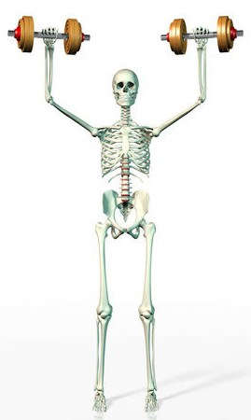
Name and locate important bones in the skeletal system
Why does your body need protection?
Function of the skeletal system:
Support
Skeletal system: The framework of the body, consisting of bones and other connective tissues.

Slide 9
Name and locate important bones in the skeletal system
Why does your body need protection?
Function of the skeletal system:
Movement
Skeletal system: The framework of the body, consisting of bones and other connective tissues.

Slide 10
Name and locate important bones in the skeletal system
Why does your body need protection?
What are the functions of these bones?
 | Protection | Support | Movement
Skull
Clavicle
Sternum
Rib Cage
Vertebral Column
Humorous
Radius
Ulna
Femur
Tibia
Fibia
Skeletal system: The framework of the body, consisting of bones and other connective tissues.

Slide 11
Protection
Support
Skull
Movement

Slide 12
Protection
Support
Clavicle
Movement

Slide 13
Protection
Support
Sternum
Movement

Slide 14
Protection
Support
Rib Cage
Movement

Slide 15
Protection
Support
Vertebral Column
Movement

Slide 16
Protection
Support
Humerus
Movement

Slide 17
Protection
Support
Radius
Movement

Slide 18
Protection
Support
Ulna
Movement

Slide 19
Protection
Support
Femur
Movement

Slide 20
Protection
Support
Tibia
Movement

Slide 21
Protection
Support
Fibula
Movement

Slide 22
Name and locate important bones in the skeletal system
Why does your body need protection?
What do these bones protect?
Skull
Brain
Skeletal system: The framework of the body, consisting of bones and other connective tissues.
Sternum
Heart and lungs
Rib Cage
Heart and lungs
Vertebral Clumn
Spinal cord
Clavicle
Nerve bundle

Slide 23
Name and locate important bones in the skeletal system
Why does your body need protection?
At what age does half of our skeletal mass develop?
Between 11 - 20
What vitamins and minerals are important for strong bones?
Calcium and Vitamin D
Skeletal system: The framework of the body, consisting of bones and other connective tissues.
How much time is recommended to be out in the sun each week?
5 to 15 minutes
- we get vitamin D from the sun
What food or drink is important in making bones strong?
Milk
- has calcium and vitamin D
What can help protect strong bones?
Exercise
- like walking and running

Slide 24
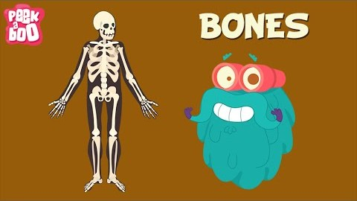
Name and locate important bones in the skeletal system

Slide 25
Name, locate and know the function of important bones in the skeletal system

